Slide 1

WELCOME!
By ~ Divyansh Jha

Slide 2
PASSING STRUCTURES TO FUNTIONS

Slide 3
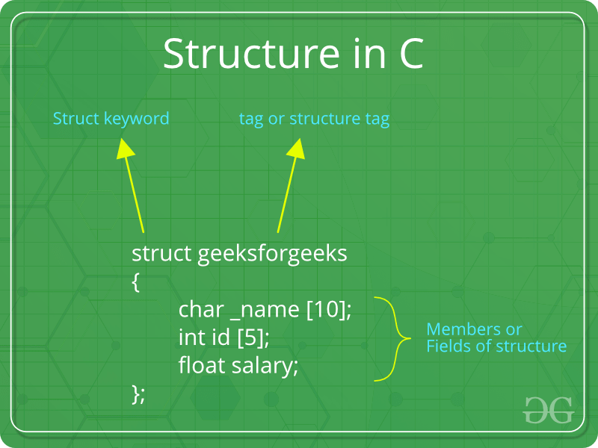
What is a structure?
User defined data type
Both in C/C++
Groups items of different data types in a single data type.

Slide 4
How to create a structure?
“struct” keyword is used
Example:
struct address
{
char name[50];
char street[100];
char city[50];
char state[20];
int pin;
};

Slide 5
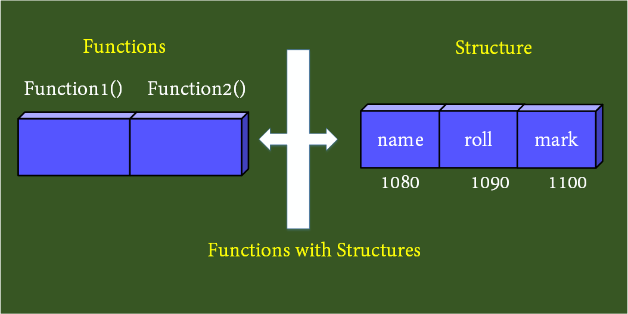
Passing struct to function
Can be passed from main function to any function
Struct definition is available within the function only.
Declare structure globally else it wont be available to other functions.

Slide 6
Ways to pass struct to function
It can be done in 3 ways:
1. By value.
2. By address(reference).
3. Declare struct globally.

Slide 7
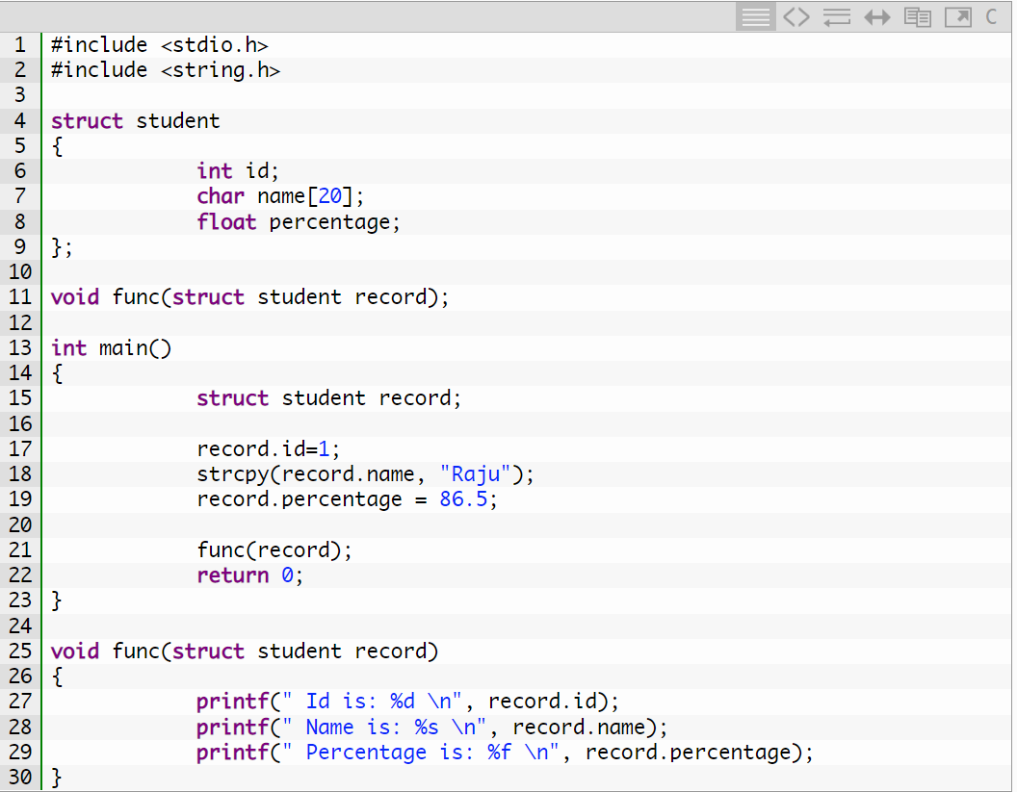
By Value
Example:

Slide 8
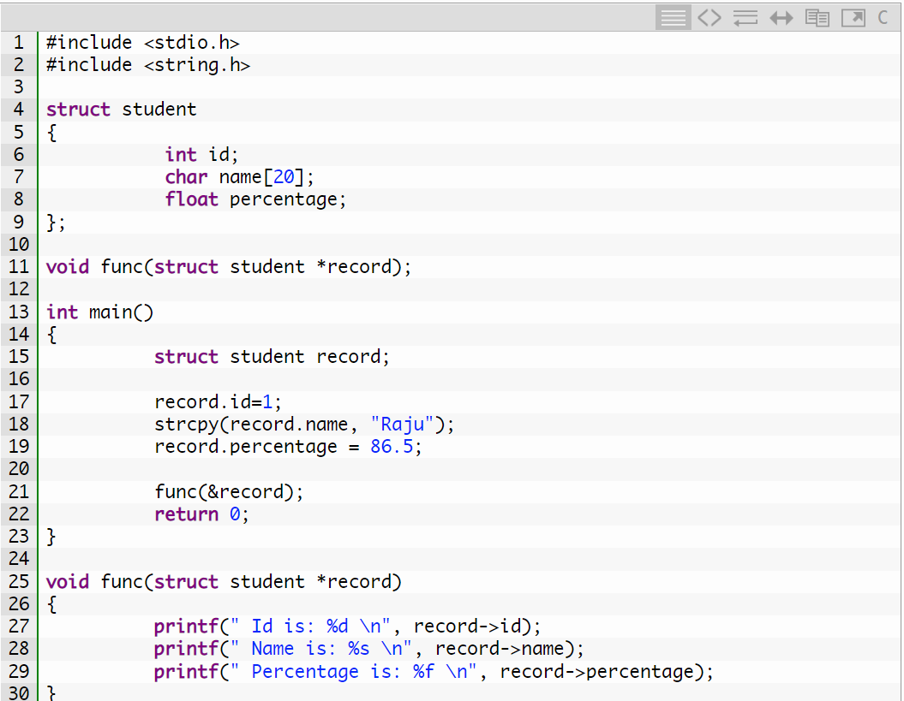
By Address
Example:

Slide 9
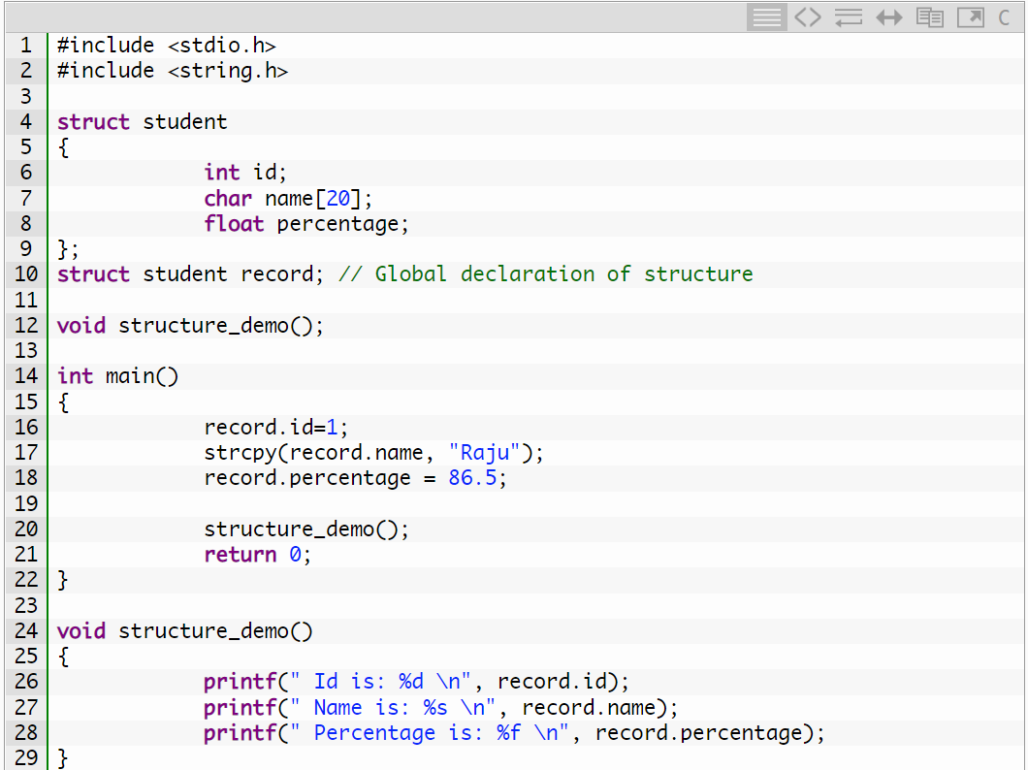
By Global Declaration
Example:

Slide 10
What you have learned
What is a structure?
How to create structs
Ways to pass structures to function:
1) By value
2) By address
3) By Global Declaration

